Slide 1

Customer Churn Prediction
Using RFM Analysis & Machine Learning
Online Retail II Dataset | 525,461 transactions | 4,312 customers
Kulwinder Bhamra

Slide 2

Agenda
1
The Problem
Why customer churn matters for retail
2
Our Data
Online Retail II dataset & cleaning pipeline
3
EDA & RFM
Exploratory analysis and RFM scoring
4
Modeling
Logistic Regression & Random Forest results
5
Insights
Key findings and next steps

Slide 3



The Challenge
In our dataset, 33% of customers churned (no purchase in 90+ days). Identifying them early is critical to retention.
525K
4,312
33%
Total transactions in the Online Retail II dataset
Unique customers after cleaning null IDs
Churn rate (1,427 of 4,312 customers)

Slide 4
Data Overview
Online Retail II dataset: 525,461 transactions from a UK-based online retailer (Dec 2009 - Dec 2010).
Column | Type | Example | Nulls
Invoice | object | 489434 | 0
StockCode | object | 85048 | 0
Description | object | 15CM Christmas Glass Ball | 2,928
Quantity | int64 | 12 | 0
InvoiceDate | datetime | 2009-12-01 07:45 | 0
Price | float64 | 6.95 | 0
Customer ID | float64 | 13085.0 | 107,927
Country | object | United Kingdom | 0

Slide 5
Data Cleaning Pipeline
01
Drop null Customer IDs
525,461 → 417,534 rows
Removed 107,927 rows with missing Customer ID
02
Fill missing descriptions
Zero nulls remaining
Replaced 2,928 null descriptions with 'Unknown'
03
Filter positive transactions
417,534 → 407,664 rows
Kept only Quantity > 0 and Price > 0 (removed returns/credits)
04
Derive TotalPrice
Median: £11.90
Created TotalPrice = Quantity x Price for monetary analysis

Slide 6
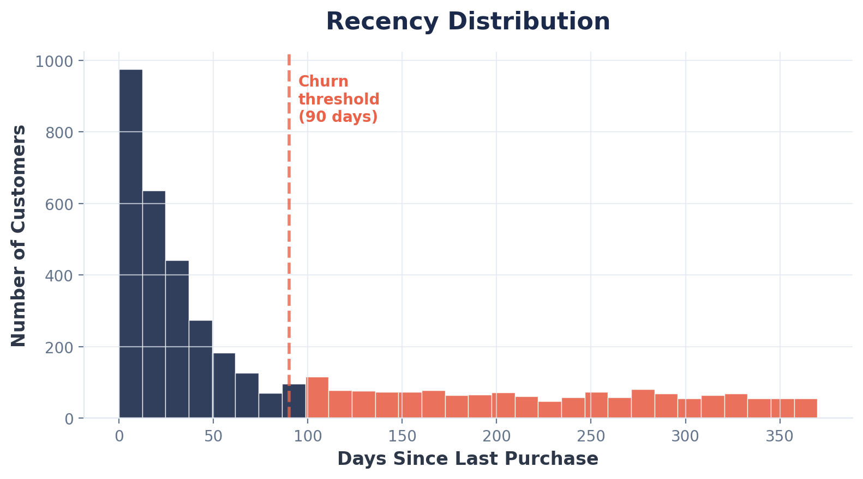
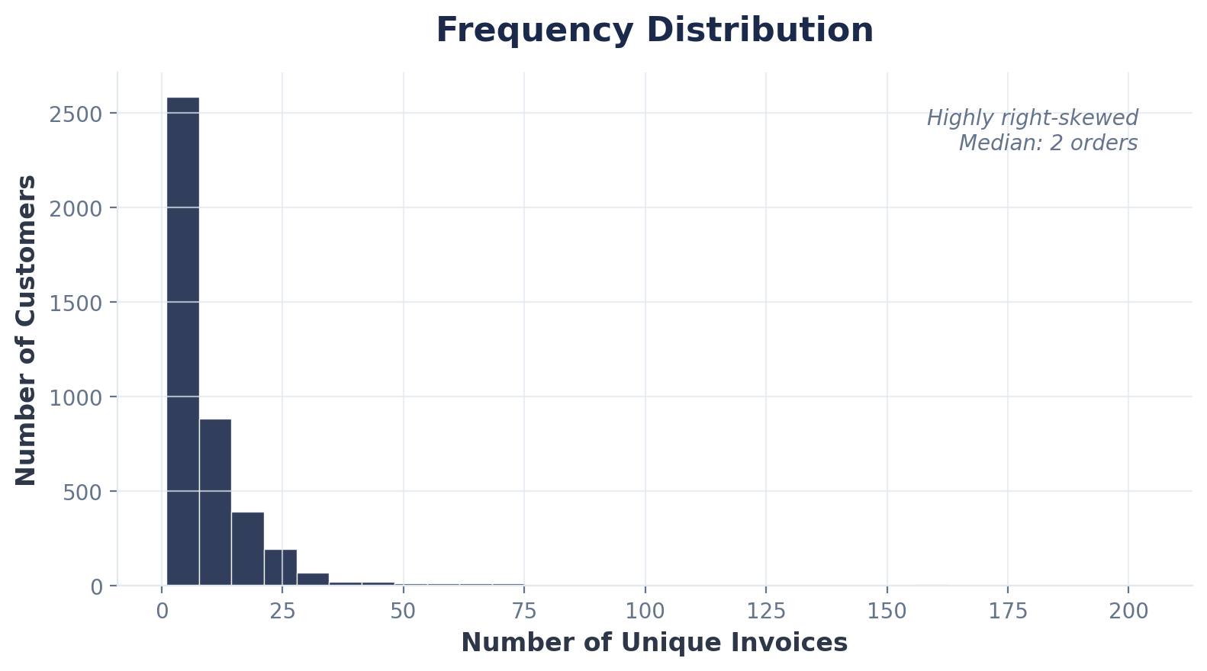
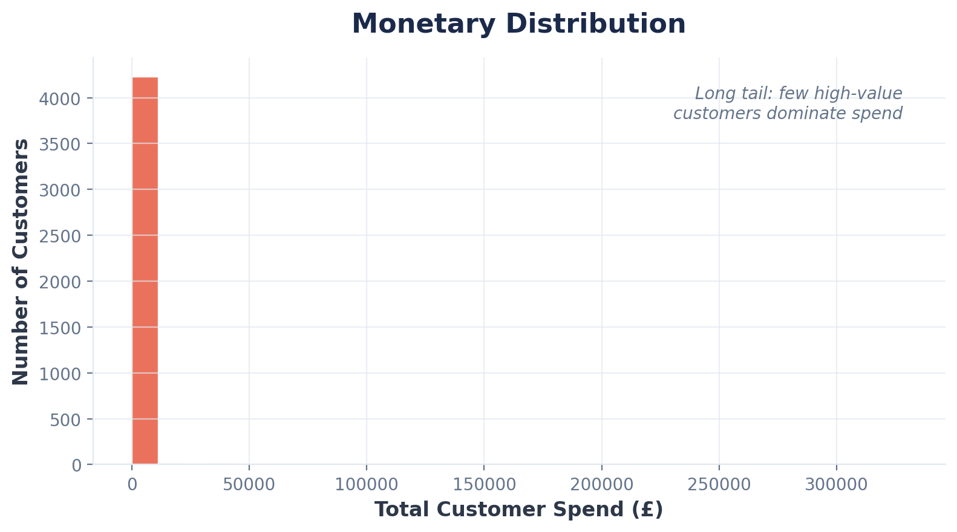
RFM Distributions
All three dimensions are heavily right-skewed — most customers cluster at low values

Slide 7
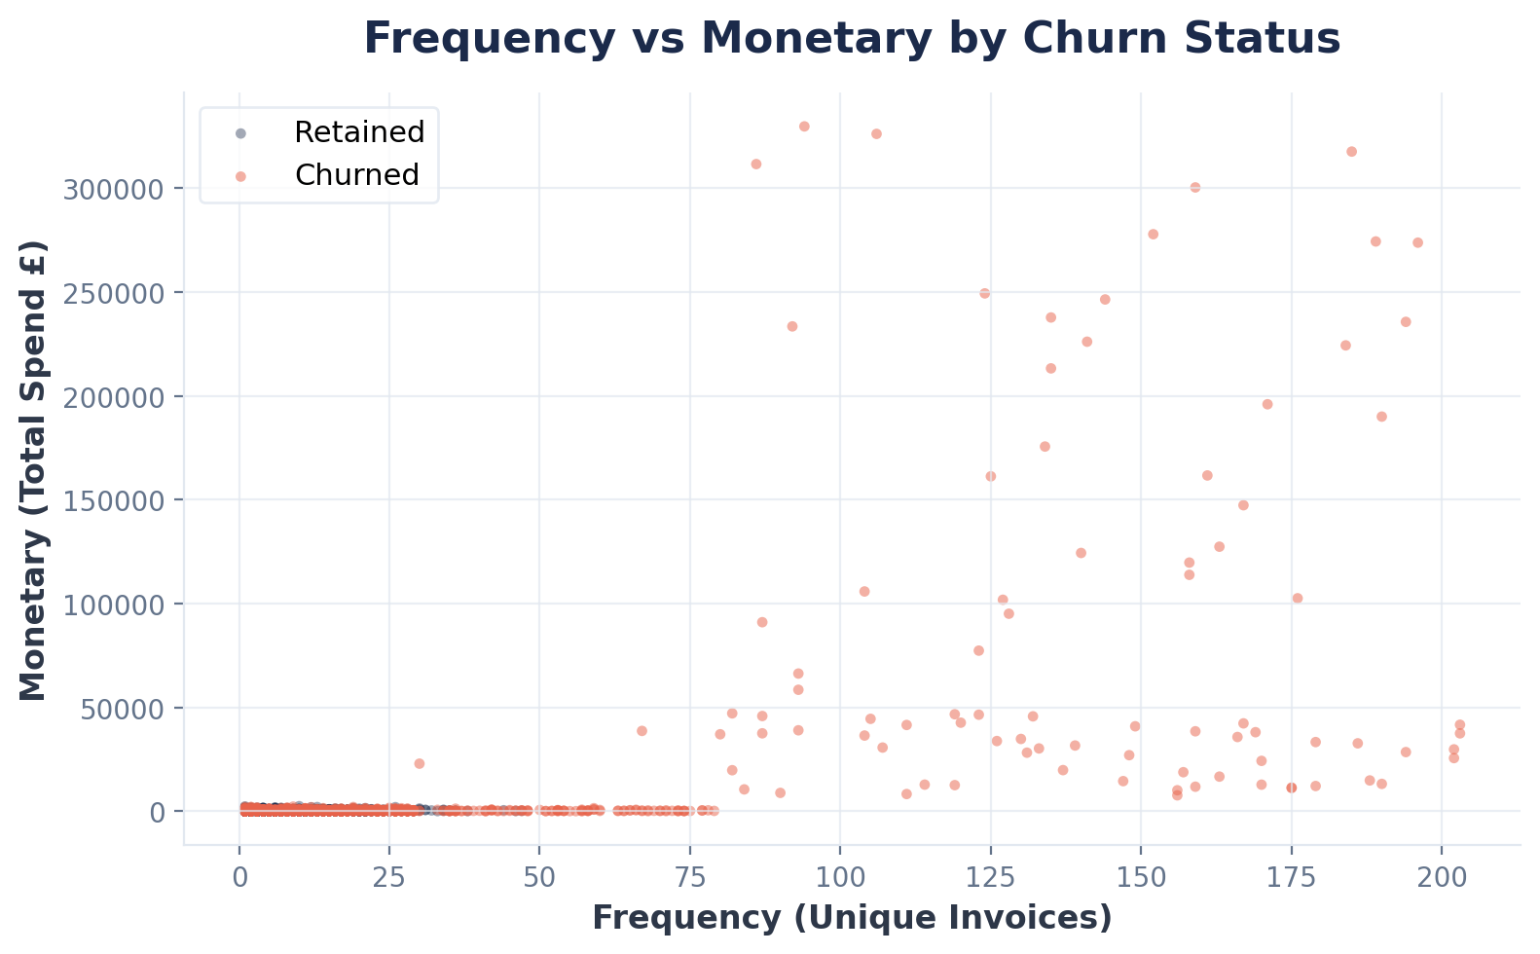
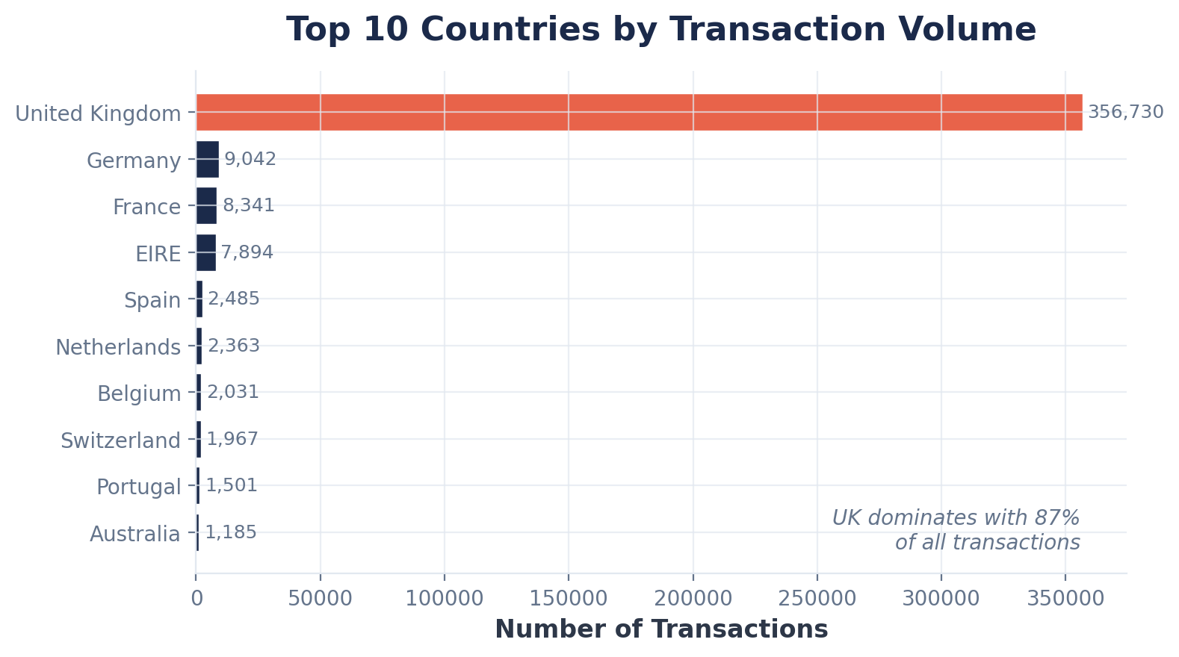
Customer Behavior & Geography

Slide 8
RFM Analysis Framework
Three behavioral dimensions scored per customer — churn defined as Recency > 90 days
R
F
M
Recency
Frequency
Monetary
Days since last purchase relative to snapshot date (Dec 9, 2010).
Count of unique invoices per customer. Median: 2 transactions.
Sum of TotalPrice per customer. Median spend: £11.90.
Churn threshold: > 90 days
Range: 1 to 205
Range: £2.95 to £349K

Slide 9
Churn Distribution
Dataset Summary
Total customers:
4,312
Retained (Recency <= 90d):
2,885 (67%)
Churned (Recency > 90d):
1,427 (33%)
Median Recency:
~50 days
Median Frequency:
2 orders
Median Monetary:
£11.90

Slide 10


Modeling Approach
Approach 1
Approach 2
Logistic Regression
Random Forest (Time-Split)
Features: Recency, Frequency, Monetary
Target: Churn (Recency > 90 days)
80/20 random train-test split
Result: 100% accuracy
Features: Frequency, Monetary only
80th percentile temporal cutoff
Churn = not active in test period
Result: 58% accuracy
Data leakage — Recency directly determines the churn label, making the model trivially perfect.
No leakage — uses only behavioral features with temporal validation.

Slide 11
Model Performance
Random Forest with time-based split — the methodologically sound approach
ROC-AUC Score: 0.671
The Random Forest model demonstrated a fair ability to distinguish between customers likely to churn and those likely to remain active.

Slide 12
Feature Importance
Random Forest classifier feature importance scores
Monetary
86.7%
Frequency
Monetary value dominates prediction — how much a customer spends is the strongest signal of future behavior.
13.3%

Slide 13
Key Findings
Data leakage matters
Monetary is the top predictor
Using Recency as a feature when churn is defined by Recency yields a misleadingly perfect model. The time-split approach is more honest.
At 86.7% feature importance, customer spend is far more predictive than purchase frequency (13.3%) in the Random Forest model.
58% accuracy — room to grow
Imbalanced classes affect results
The Random Forest without Recency achieves 58% accuracy. Additional features (product diversity, seasonality) could improve this.
With 67% retained vs 33% churned, the model performs better on the majority class. Resampling or cost-sensitive learning could help.

Slide 14

Next Steps
Add more features: product category diversity, return rate, day-of-week patterns
Try gradient boosting (XGBoost / LightGBM) for better accuracy
Ready to
Improve?
Apply SMOTE or class weighting to handle the 67/33 imbalance
Tune hyperparameters with cross-validation on the time-split
Target: 75%+ accuracy with enriched features and tuned models.
Build a scoring pipeline for real-time churn risk assessment

